Slide 1
How time of interview affects respondent demographics
Georgia Malach

Slide 2
Contents
Background and reasons for research
Review of the dataset
Findings: Chi square tests
Findings: Categorical Naïve Bayes Classifier
Comparing to past data
Conclusions and next steps

Slide 3
Background and reasons for research
QVC is a television shopping channel with approximtely 16 million viewers.
GfK runs a 5 minute tracking survey asking about respondents‘ shopping habits.
An agency conducts the telephone interviews.
Historcially, the survey has always been conducted during consumer hours (weekends and evenings).
Agency has pushed to move this to business hours recently due to the fact that more people are working from home.
This research is to find out if the distinction between consumer and business hours is necessary (i.e. The demographic of respondent who answers during business hours is in fact different to those who answer during consumer hours)

Slide 4
Tests
Demographics: Gender, Age, Employment Status, Social Class
Chi square tests were performed to determine the relationship between time of survey and the four demographic measures.
Categorical Naive Bayes was also used to see if respondents could be classified into consumer or business hours based on their demographics.

Slide 5
Review of the data set
1,116 respondents
No missing values
Responses between 14/12/21 and 13/01/22
Distinction between consumer and business hours was calculated using the following times:
Business hours | Consumer hours
9:00 – 17.30pm Mon-Fri | Before 9:00 and after 17:30 Mon-Fri
 | Saturday and Sunday

Slide 6
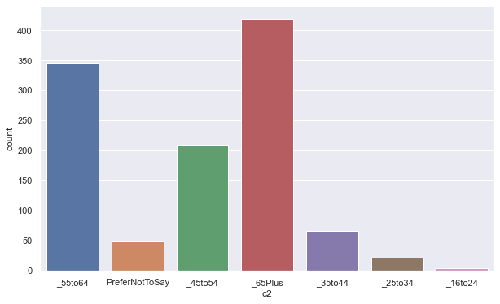
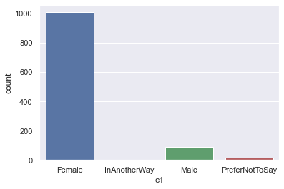
Heavily female and older sample

Slide 7
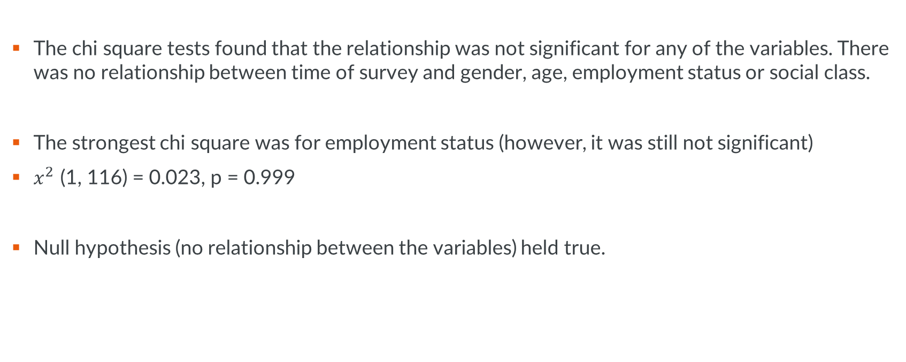
The findings: Chi square
The chi square tests found that the relationship was not significant for any of the variables. There was no relationship between time of survey and gender, age, employment status or social class.
The strongest chi square was for employment status (however, it was still not significant)
$x^{2}$ (1, 116) = 0.023, p = 0.999
Null hypothesis (no relationship between the variables) held true.

Slide 8
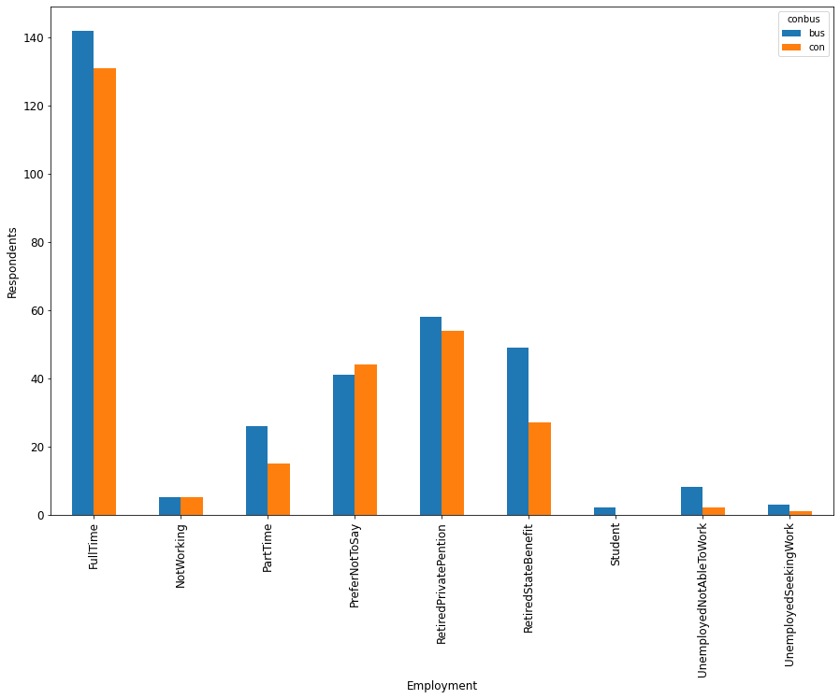
By viewing the data, the largest difference can be seen for Retired respondents

Slide 9
The findings: Categorical Naive Bayes Classification
Naïve Bayes Classifiers – probabilistic classifiers based on Bayes Theorem (mathematical formula for determining conditional probability – which is the likelihood of an outcome occurring, based on a previous outcome occurring).
Naïve Bayes tests were conducted using Age, Gender, Employment status and Social grade as features and consumer vs business as the classifier.
Can we classify respondents into either consumer or business hours based on the four key demographics?
If we use Recall (the proportion of actual positive incidences that are identified correctly) as the measure, this is 0.52
Therefore, it correctly identifies 52% of all business repsondents. This is not a very strong model.

Slide 10
The findings: Categorical Naive Bayes Classification
The model assumes no multicollinearity between the variables. Although the level of corelation between features is acceptable , there is some corelation:
VIF = variance inflation factor (below 5 considered is acceptable)
VIF | features
0 | 1.107297 | Gender
1 | 4.965820 | Age
2 | 2.451360 | Employment
3 | 4.410326 | Social Grade
4 | 1.701651 | Business / Consumer

Slide 11
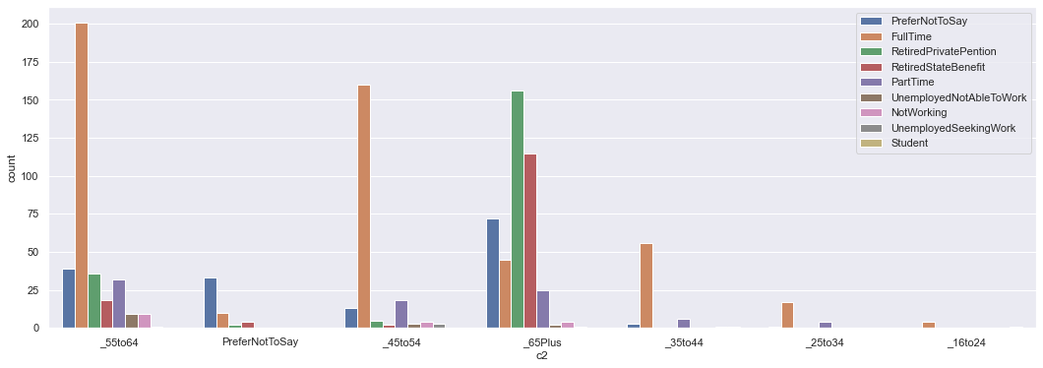
Comparing to past data (pre-pandemic)
Unfortunately we don’t have data for employment status or social grade pre-pandemic
We can assume some corelation between age and employment status though from this data:

Slide 12

Comparing to past data (pre-pandemic)
However, chi square tests on data from 2017, still showed no significant corelation between Age and Time of interview:
$x^{2}$ (1, 117) = 0.021, p = 0.999
Suggesting that perhaps Time of inteview was never corelated to the demographic of respondent.

Slide 13
Conclusions and next steps
The findings suggest that the time interviews are conducted make no difference to the demographic of respondent, therefore, it may make little sense to be tracking the number of respondents in business and consumer hours after all.
Could this aspect of the survey be dropped?
The fact it’s such a skewed sample – older females (QVC customers) – could affect the results. It would be interesting to conduct the same tests on a similar project with a more varied sample.
Dive deeper into specific codes that do look like they may be significant. E.g. Retired and older respondents are more likely to answer during business hours.
This is a tracking study so we could continue measuring it over time. The next wave is in March – run the survey then when more people are likely to be back in the office. Could we see a change of time as we go back to normal or are we in fact in a “new normal”?

Slide 14
Thank you Any questions?

